Slide 1
ROSI Territorial development
Juan José Urrego Hernandez
Cristian Camilo Herreño Mojica
November 2021

Slide 2







Ecopetrol Territorial development
INTERNATIONAL REPORTS AND STANDARDS
OIL & GAS SECTOR
BEST PRACTICES
Private sector interventions in the territories where they operate should seek to have a positive "societal" impact, promote equitable development and consensus.
Impact assessment: Generating value for the beneficiaries of the company's social investment programs and shareholders. KPIs that measure the effectiveness of activities.
Strategies aimed at relationships based on mutual recognition and respect, trust, participatory dialogue, and creation of shared value.
Social investment strategy priorities aligned with the goals of the Sustainable Development Goals (SDGs) and business drivers.
1
Social return on investment
Access to basic services: Energy, gas, drinking water and basic sanitation. (SDGs 6 and 7); education (STEM) and health (SDGs 3 and 5).
Proactive and inclusive dialogue with communities that generates mutually beneficial results.
Impact assessment of social investment projects
Impact on territories measured by impact on SDGs
2
Support for entrepreneurship (economic diversification), local employability (SDG 8), and supplier development.
Direct economic value generated and distributed (EVG&D) to communities and territories.
Policies and commitments for the management of relations with migrant communities, ethnic communities, and human rights (including relations with immigrant and/or nomadic populations)
3
Generation of greater equity and connectivity in the territories throughout the company's value chain.
STEM: Science, Technology, Engineering and Mathematics

Slide 3

Objectives
Develop and implement a standard methodology that allows Ecopetrol to quantify the return on its investments in sustainability. Strengthen decision-making in the processes for allocating SosTECnibility* resources, through the incorporation of criteria for measuring the associated benefits. Strengthen the disclosure to the market of information associated with sustainability issues. Align diverse organizational efforts aimed at the financial analysis of sustainability impacts (construction of roadmaps, reporting standards, business risks, etc.)
* SosTECnibility: Strategy of Ecopetrol with sustainable goals to 2040 in carbon emissions, social investment, water treatment and portfolio diversity with renewable energy and hydrogen investments.

Slide 4
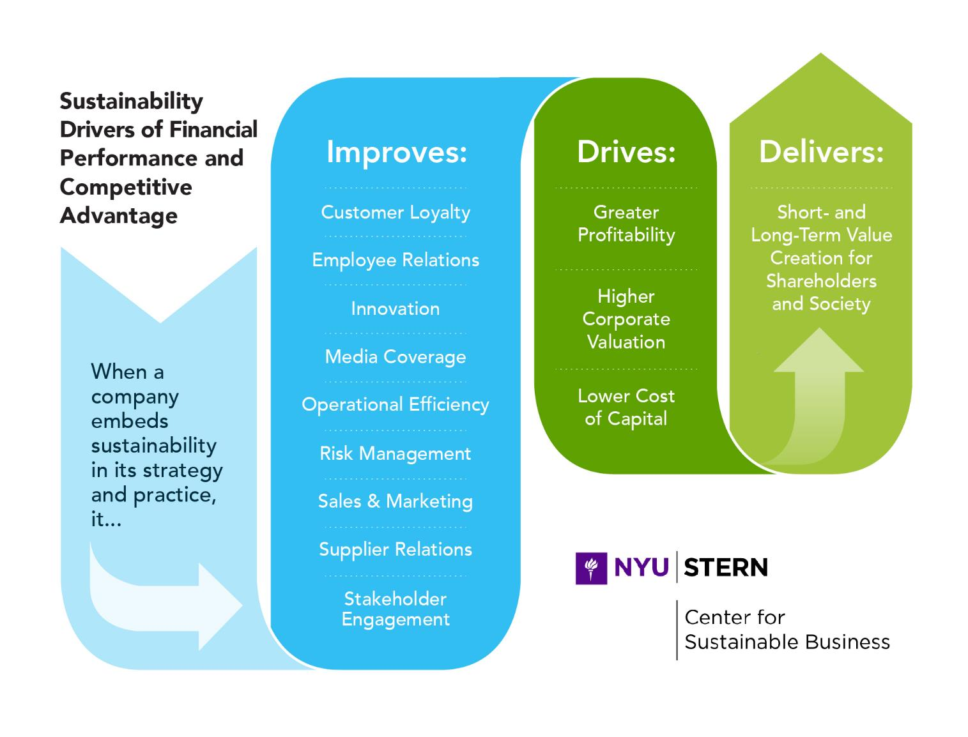
Return on Sustainability Investment Methodology
The Business Case for Territorial development Social Investments is focused on the Mediating Factor of Risk Management, which leads to higher profitability, higher capital valuation and lower cost of financing.
Social investment for Territorial development improves the profile of corporate risk management in the following dimensions
On the Business Risk Map, it is declared as Risk No. 5. The risk of discontinuity of operations due to incidents related to social demands. For the purposes of the pilot, operational risk is suggested as the primary source of benefits for the management of social investment, based on the availability of metrics and available historical data for the design of the evaluation model.
Operational Risk
Reputational Risk
Regulatory Risk

Slide 5


STAGES
1. Identification
Methodological approach
ROSI – Social Investment Territorial development
Identification of social investment projects. For this step, the following was done:
Definition with Administrative, Social Prosperity and Regional Environment Managements for the execution of the 2021 pilot in Orinoquía (Eastern Colombia Region). An analysis of the Social Investment Portfolio was carried out for the Castilla 1 – TIER 1 asset composed of 19 strategic social projects (August 10)
Result: In this first step, it was identified that from the point of view of the social team workin in that region concluding that the viability of a territory does not depend on a single social investment project but on the set of projects that are executed in the area.
2. Impact Assessment
Identify the material changes generated in the Territorial development strategy:
Preliminary analysis and validation of mediating factors together with the Orinoquía environment team.
Result: It is difficult to differentiate the impact within the company and for the Society and Community interest group. Therefore, an analysis was carried out based on the mediating factors and priority was given to those in which a more significant influence is evidenced: Operational Efficiency, Supplier Relations, Risk Management, and Media Coverage.

Slide 6
STAGES
3. Proceeds
Methodological approach
ROSI – Social Investment Territorial development
Identification and analysis of the benefits generated by the sustainability strategy: From the factors mentioned in the previous slide, the following was reached.
Results:
The most notorious benefits are those related to the Risk Management factor associated with operational risk. The most significant potential benefit of the Territorial development strategy is the reduction of the social risk materialized in environmental incidents and the costs associated with them.
4/5. Quantification and Monetization
A quantification and monetization model was analyzed to analyze the contribution of social investment in the reduction of incident materialization based on data on social investment, environmental incidents, deferred barrels and non-productive times.
Result:
Based on the available information, a simple regression model was made, with a moving average, graphical analysis and inference of the data for Castilla field, obtaining as a result that there would be no significant correlation between social investment and the other variables.

Slide 7




Sustainability drivers
For the impact assessment and identification of benefits in the prioritized mediating factors (steps 2 and 3), meetings were held with different teams of the Castilla asset related to the factors.
Risk Management
Operational Efficiency
Supplier Relations
Media Coverage
Social investment could have an indirect impact on incident risk mitigation and its impact on NPT (Non-Productive Times) and Deferred Barrels.
Meetings:
Orinoquia social Team Center for Strategic Analytics (CAE)
Some social investment projects could have an indirect benefit on suppliers (e.g productive project in alliance with FAO to give technical assistance to local farmers), however, there is no clarity regarding their estimate. Road infrastructure projects would be the ones with the most notable benefits in the supply chain.
Meetings:
Supply team, Castilla asset
Some projects of the sustainable development project have a possible direct benefit in operation (ASA project which have the objective to analyze the use of treated water extracted from the oil fields to use it in local crops with the assistance of Sabanas del Rosario aqueduct).
Meetings:
Castilla Operations & Active Development Team Castilla Asset Project Team
The Free Press indicator was identified, which is the cost that Ecopetrol would save if it paid for media coverage. This indicator, which is at the regional level, did not have the detail for assets and its relationship with social investment was complex to estimate.
Meetings:
Communications Equipment Castilla

Slide 8
NPT/Deferred Occurrence Probability Model
In 2020, the CAE (Center for Strategic Analytics of Ecopetrol) together with iData carried out a study on a model of the probability of occurrence of deferred and NPT (Non-Productive Times). The study had nationwide data from 2018 to July 2020 and covered the relationship of NPT and Deferred with environmental events, labor, supply contracts, among others, for the estimation of a probabilistic model. The conclusions were as follows: There is no significant correlation of environment events with NPT and deferred production. The highest correlation found was 0.7 in Barrancabermeja and strongly associated with incidents of demands for local goods and services. There is no presence of seasonality in environmental incidents, i.e. there is no pattern of incidents over time.

Slide 9
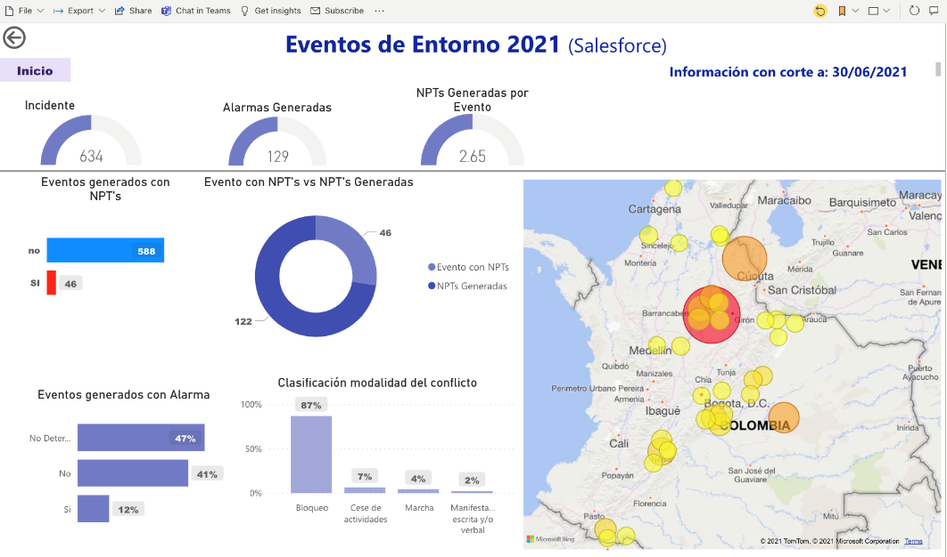
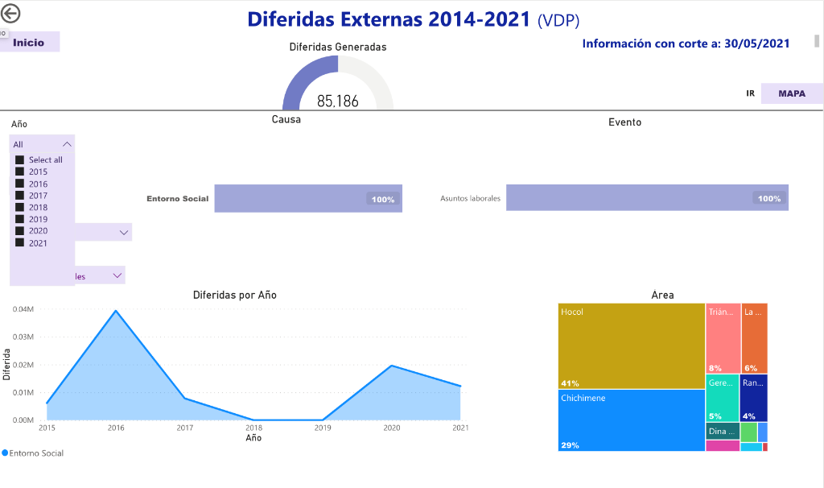
Return on Social Investment in Territorial development
Based on the Descriptive Analytical Models developed by the CAE – Center for Strategic Analytics of Ecopetrol, we are in the phase of predictive statistical analysis to identify the correlation factors between local investment and environmental events, and the relationship of these with NPT (Non- Productive Times) and deferred oil production.
It will be based on the recorded and documented historical information of NPT, deferred production, social incidents and social investments for the period 2018-2021
Y = ⍺ + β 𝑥
β = Correlation Coefficient between Aggregate Social Research & Environment Events
https://app.powerbi.com/groups/me/reports/edbc7aab-8e15-47ac-b967-01aca4cd17be/ReportSection8a82635479e9308c85b4?ctid=a4305987-cf78-4f93-9d64-bf18af65397b

Slide 10
Castilla oil field
Area of influence Castilla
Taxonomy
TIER Asset: 1*
Initial Social Risk: 10% (Low)
Social Risk with Manageability: 10% (Low)
Villages of Influence Municipality of Castilla La Nueva | Betania | San Agustín
 | Caño Grande | El Turuy
 | Cacayal | San Antonio
 | Sabanas del Rosario | San Lorenzo
 | El Centro | Las Violetas
Villages of influence Municipality of Acacías | El Triunfo | La Primavera
 | Santa Rosa | La Unión
 | Patio Bonito
Villages of influence Municipality Villavicencio | Vegas del Guayuriba
Main causes of social risk | Delays in the attention and fulfillment of commitments by Ecopetrol.
 | Rejection of the execution of activities with environmental authorizations that generate conflict of use (capture and dumping versus anthropic activities).
 | Ecopetrol's lack of opportunity for the execution of socio-environmental investment.
 | Rejection of the application of the regulations on manpower and the Public Employment Service.
Investment lines that contribute to the mitigation of social risk | Public Services (Water and Basic Sanitation)
 | Inclusive Rural Development
 | Entrepreneurship and Business Development
 | Community Infrastructure
Notes:
Taller de alineación estratégica 7 de Julio
Taller identificación 4 de Agosto
Taller evaluación de impacto e identificación de beneficios 11 de Agosto

Slide 11
Surrounding social incidents by event theme
The 4 event themes with the highest incidents for 2019-2021 are Physical Security (36), Contract Management (34), Local Manpower Requirements (29) and Union Affairs (19)
From 2019 to 2020, the topic with the highest percentage growth of environmental incidents was Local labor with 200%, however, with a cut-off until July 2021, it decreased significantly, having a drop of 95% compared to 2020.

Slide 12
Incidents 2019-2021 (July)
The total number of incidents for 2019 was 55 and for 2020 it was 53, which meant a decrease of 3.6% compared to 2019. As of July 2021, there have been 28 incidents with an average duration of 42 hours/incident. This represents an increase of 445% compared to the average duration in hours in 2020. A seasonality in the incidents is preliminarily identified, with an increase in the first quarter of the year and a decrease in the last quarter of the year.

Slide 13
Castilla oil field
Social indexes and social investment correlation with social incidents
Municipal Multidimensional Poverty Measure
Source: National Population and Housing Census (CNPV 2018)
*Incidents extracted from the Environment Incidents and Alarms database for the area of influence of the Castilla asset. The area of influence of the asset includes Castilla la Nueva, villages of Acacías (El Triunfo, Santa Rosa, Patio Bonito, La Primavera, La Unión) and a village of Villavicencio (Vegas del Guayuriba).
Notes:
Taller de alineación estratégica 7 de Julio
Taller identificación 4 de Agosto
Taller evaluación de impacto e identificación de beneficios 11 de Agosto

Slide 14
What's next?
Taking into account the objectives set at the beginning of the methodology and in order to achieve their fulfillment, the following steps are proposed:
Creation of baselines in some indicators according to the mediating factors that facilitate the quantification of the impact. Example: Baseline of times associated with the benefit obtained in road infrastructure projects, supplier bases and costs associated with environmental and legal restrictions. Integration of the different databases through unique and standard identifiers that allow the databases to create relationships: Example: Incident and NPT databases. Create synergies between the teams involved in the mediating factors and estimation models that can facilitate the methodology.
*This project concluded in January 2022. After, Ecopetro decided to work with consultancy companies to measure the impact of social investment based on the conclusions and data gathered for this project. The team that participated in the presented project kept continue working in the following projects which results are currently confidential.

